Slide 1



KPMG
View in Power BI
Last data refresh:
10/23/2021 6:29:35 PM UTC
Downloaded at:
12/2/2021 9:21:23 PM UTC

Slide 2
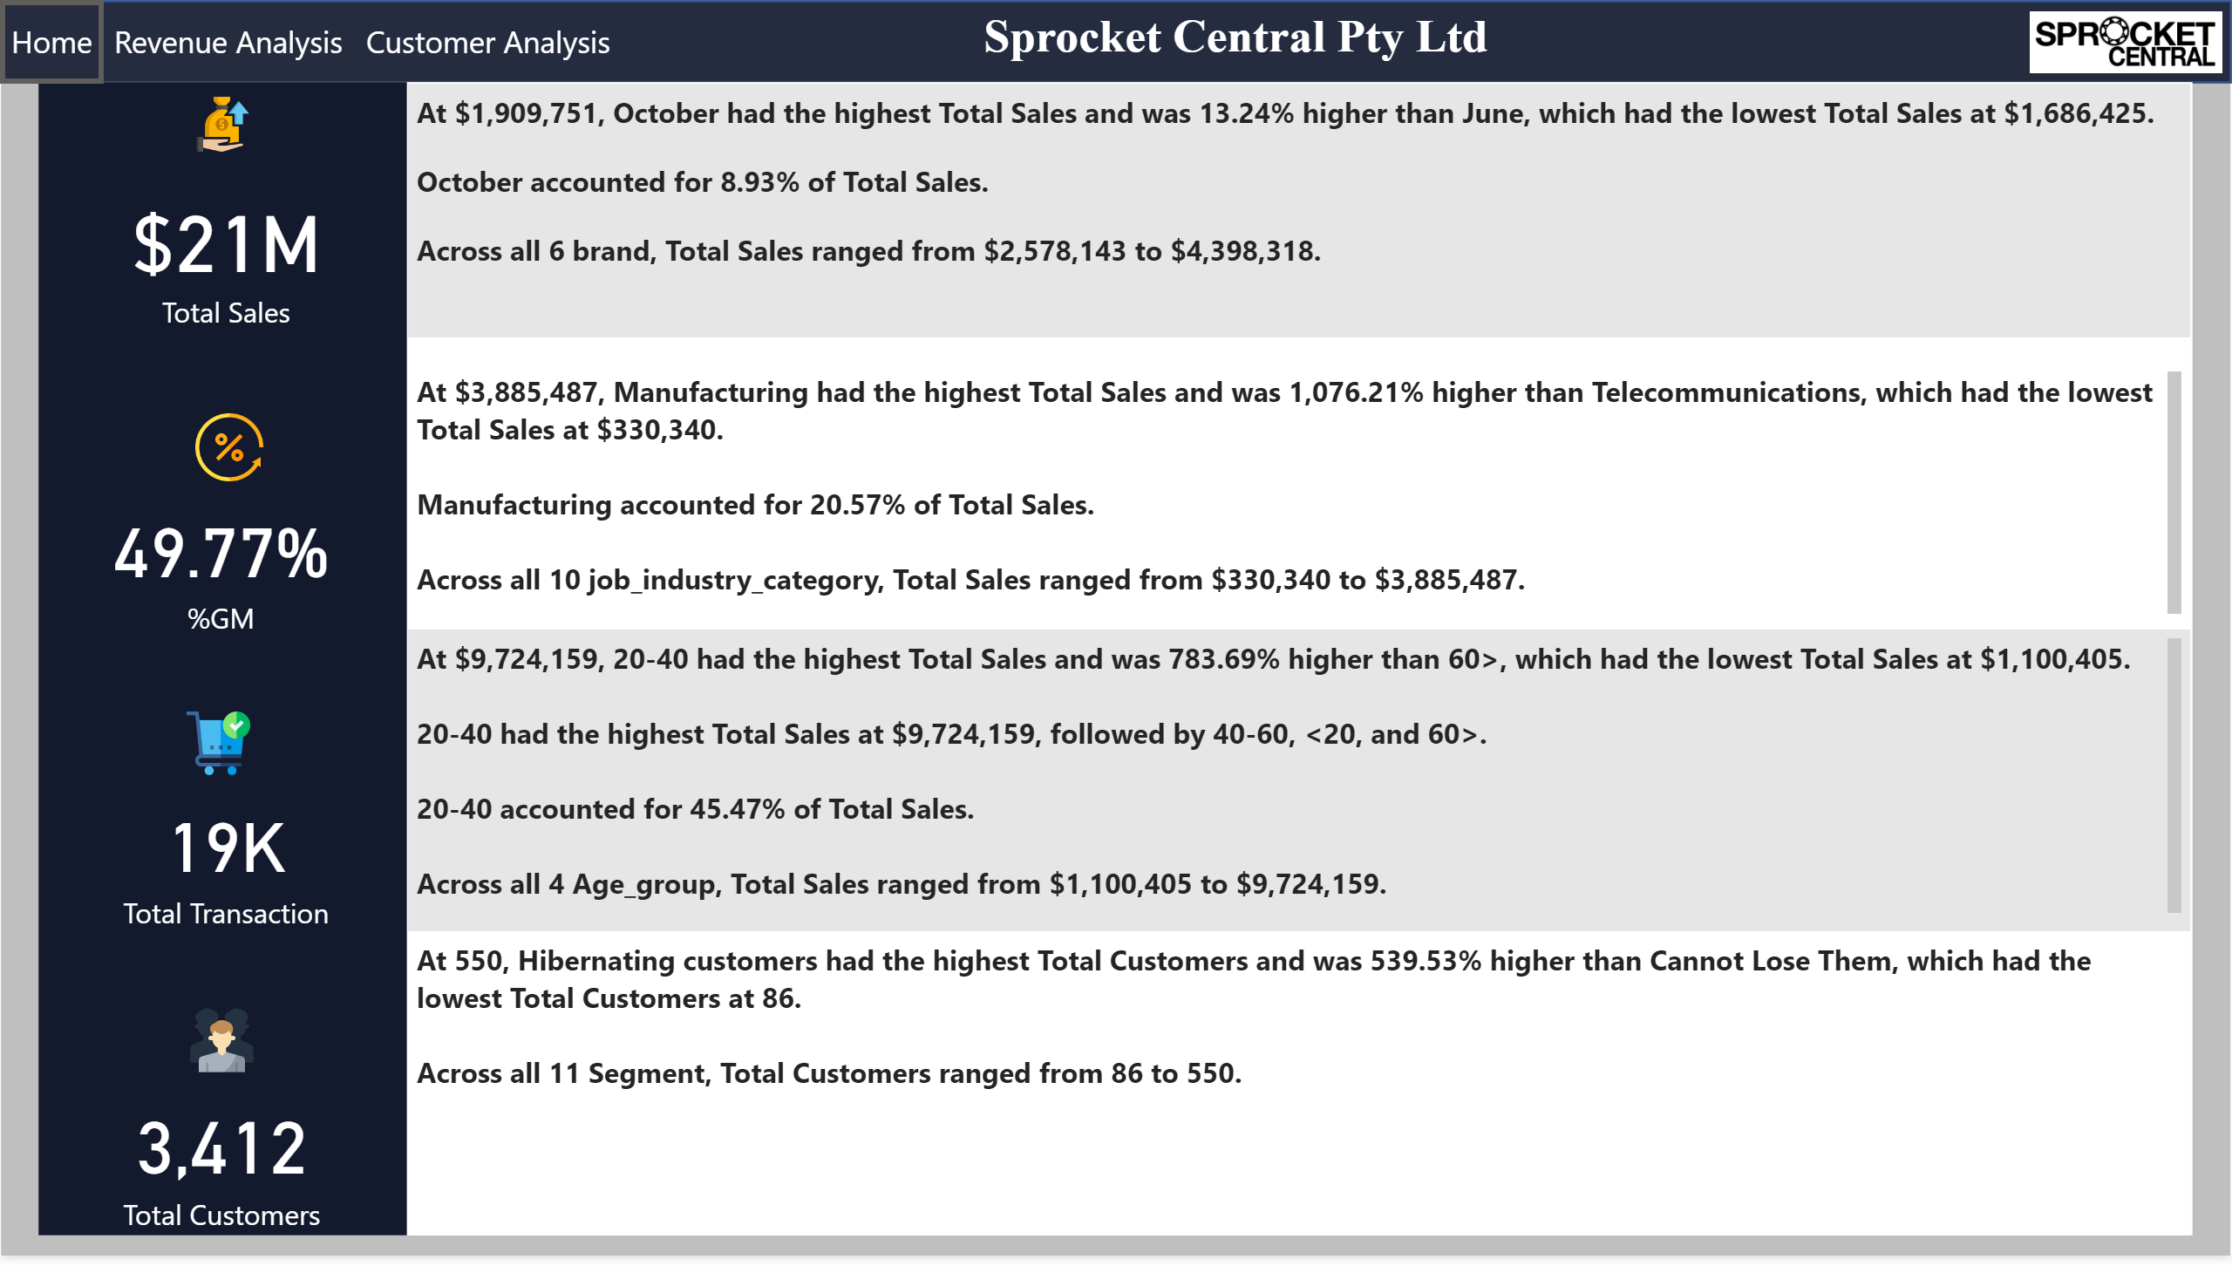
Home
Notes:
actionButton
No alt text provided.
actionButton
No alt text provided.
actionButton
No alt text provided.
actionButton
No alt text provided.
image
No alt text provided.
image
No alt text provided.
card
No alt text provided.
image
No alt text provided.
card
No alt text provided.
image
No alt text provided.
card
No alt text provided.
image
No alt text provided.
card
No alt text provided.
textbox
No alt text provided.
textbox
No alt text provided.
textbox
No alt text provided.
textbox
No alt text provided.
textbox
No alt text provided.

Slide 3
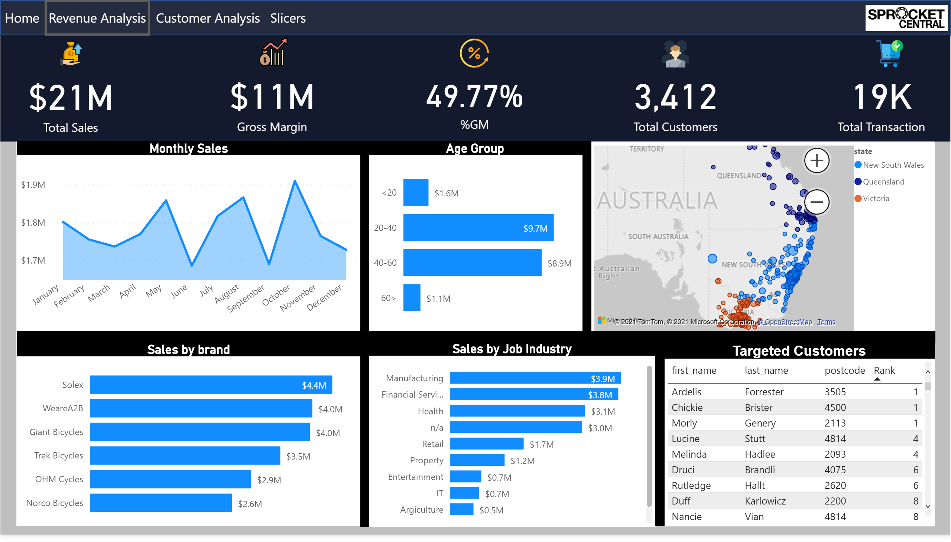
Sales
Notes:
Monthly Sales
No alt text provided.
Age Group
No alt text provided.
map
No alt text provided.
Targeted Customers
No alt text provided.
Sales by Job Industry
No alt text provided.
Sales by brand
No alt text provided.
card
No alt text provided.
card
No alt text provided.
card
No alt text provided.
card
No alt text provided.
card
No alt text provided.
shape
No alt text provided.
shape
No alt text provided.
shape
No alt text provided.
shape
No alt text provided.
shape
No alt text provided.
multiRowCard
No alt text provided.
image
No alt text provided.
image
No alt text provided.
image
No alt text provided.
image
No alt text provided.
image
No alt text provided.
image
No alt text provided.
actionButton
No alt text provided.
actionButton
No alt text provided.
actionButton
No alt text provided.
actionButton
No alt text provided.
textbox
No alt text provided.
textbox
No alt text provided.
textbox
No alt text provided.
slicer
No alt text provided.
slicer
No alt text provided.
slicer
No alt text provided.
slicer
No alt text provided.
textbox
No alt text provided.
shape
No alt text provided.
image
No alt text provided.

Slide 4
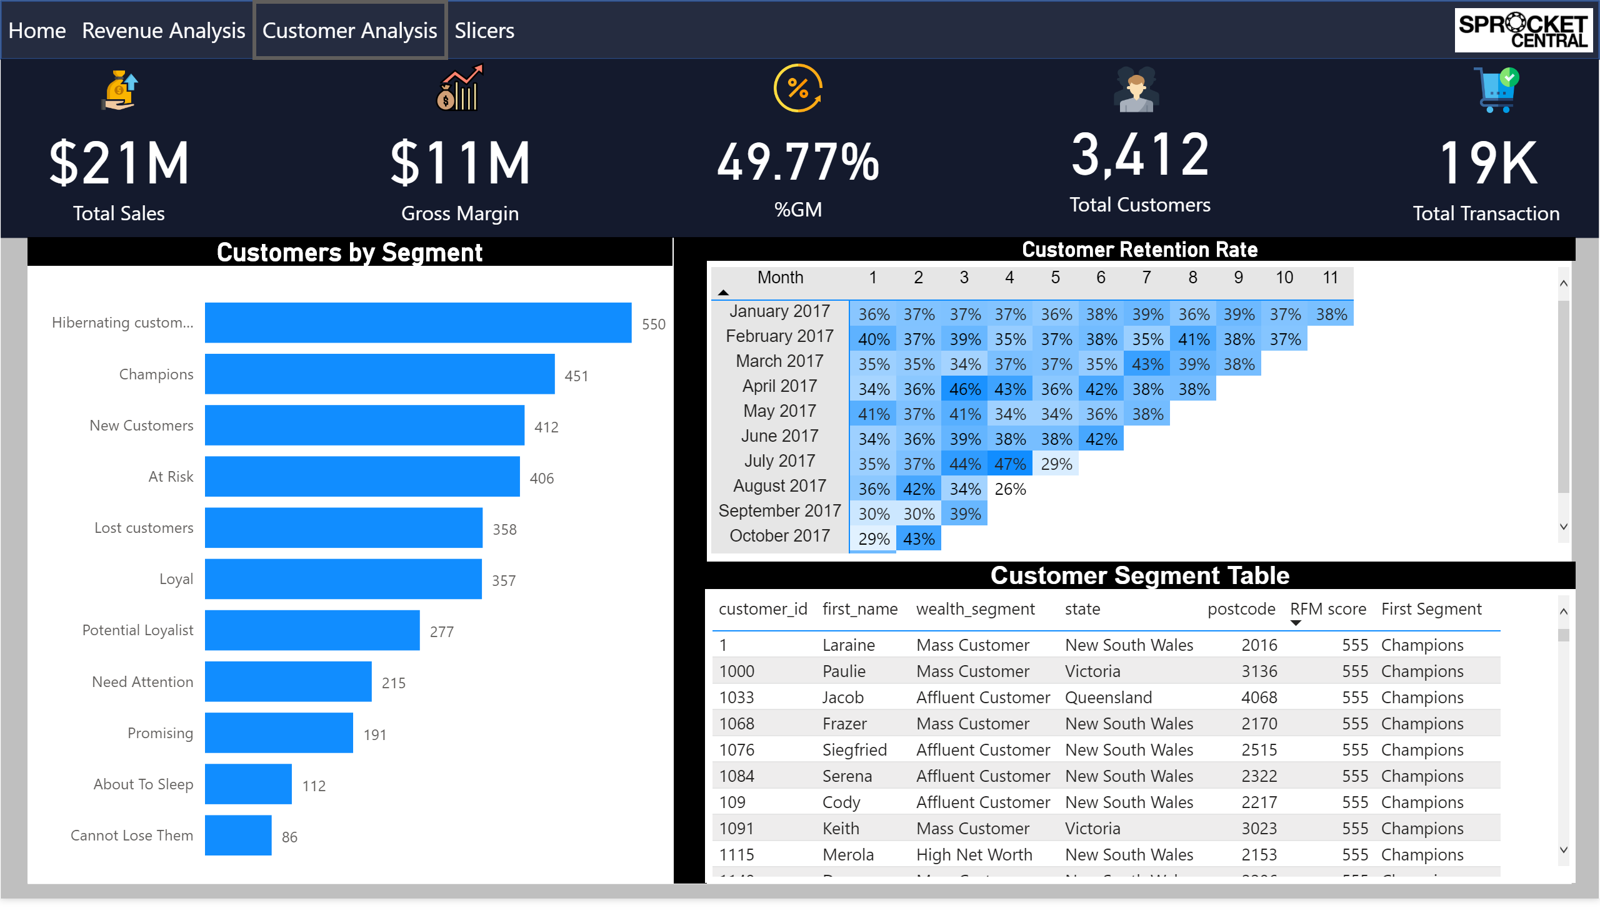
Customers
Notes:
card
No alt text provided.
card
No alt text provided.
card
No alt text provided.
card
No alt text provided.
card
No alt text provided.
Customers by Segment
No alt text provided.
Customer Retention Rate
No alt text provided.
Customer Segment Table
No alt text provided.
shape
No alt text provided.
image
No alt text provided.
image
No alt text provided.
image
No alt text provided.
image
No alt text provided.
image
No alt text provided.
actionButton
No alt text provided.
actionButton
No alt text provided.
actionButton
No alt text provided.
actionButton
No alt text provided.
image
No alt text provided.
textbox
No alt text provided.
textbox
No alt text provided.
textbox
No alt text provided.
slicer
No alt text provided.
slicer
No alt text provided.
slicer
No alt text provided.
slicer
No alt text provided.
textbox
No alt text provided.
shape
No alt text provided.
image
No alt text provided.

